Slide 1
CSMA Protocol

Slide 2
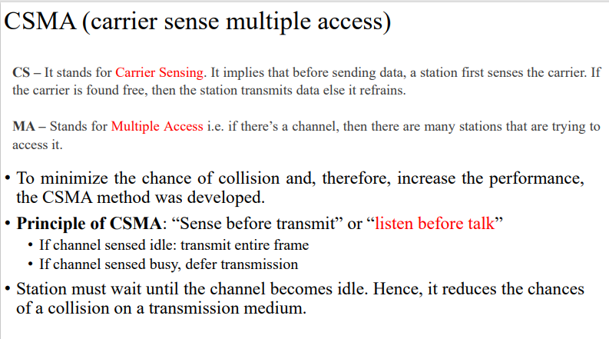

Slide 3
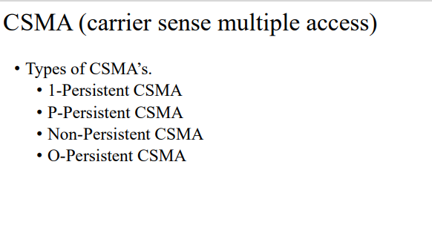

Slide 4
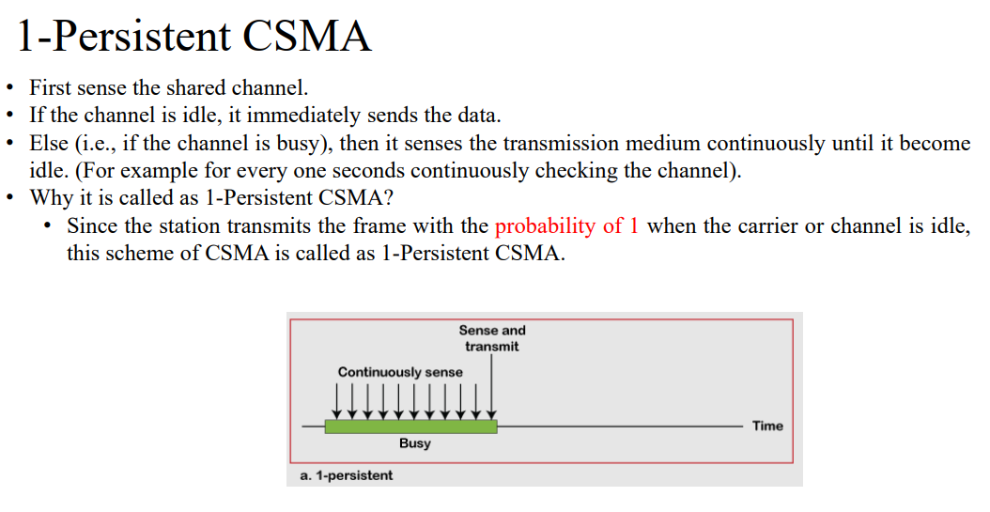

Slide 5
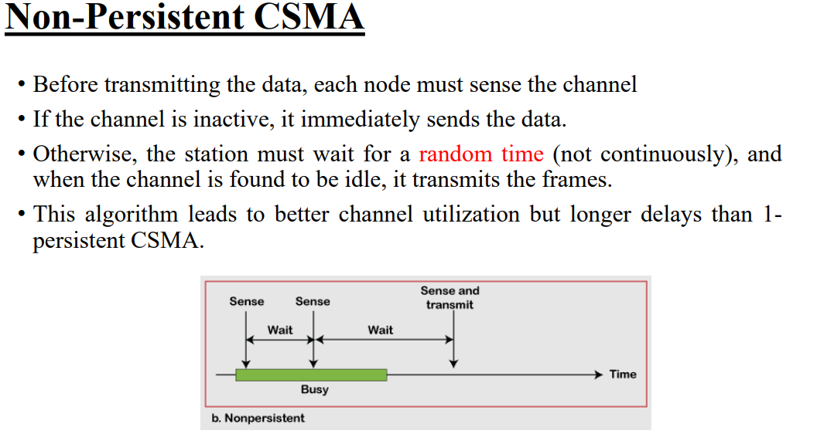

Slide 6
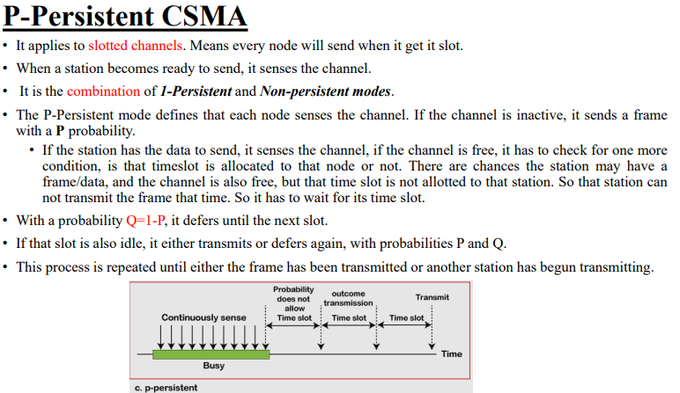

Slide 7
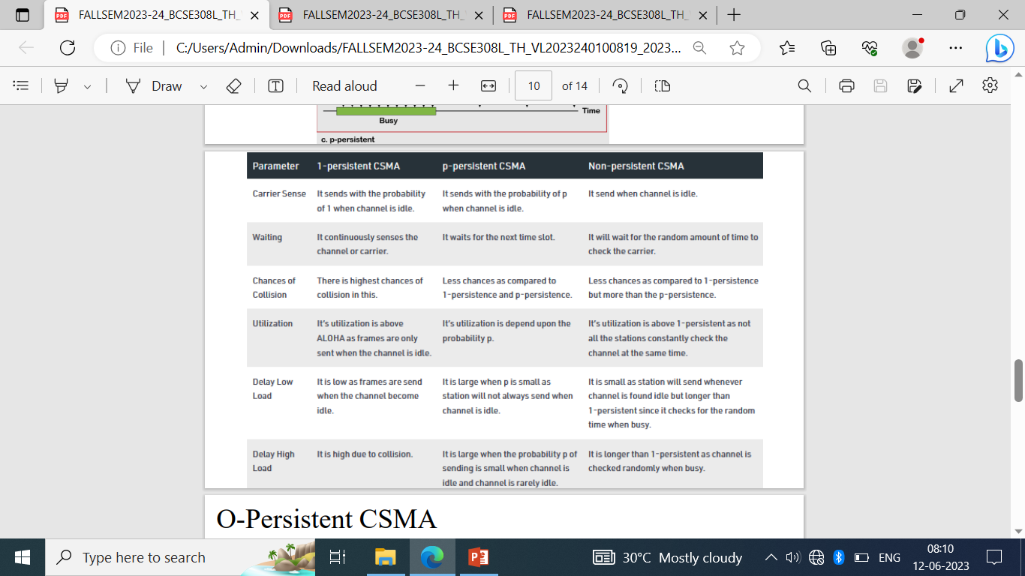

Slide 8
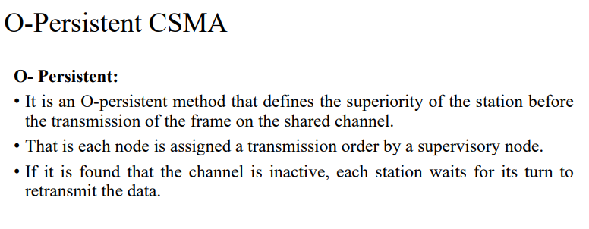

Slide 9
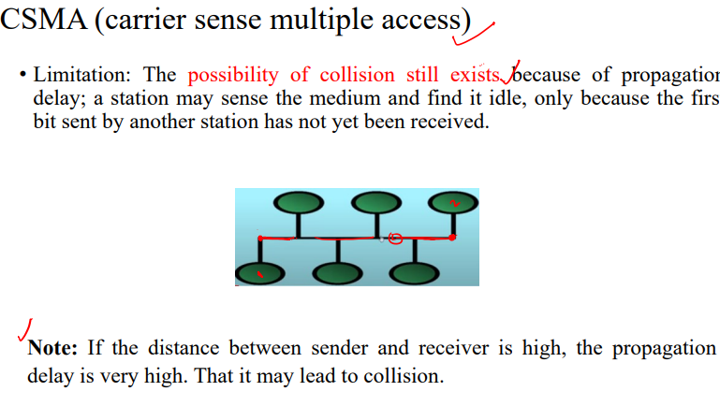

Slide 10
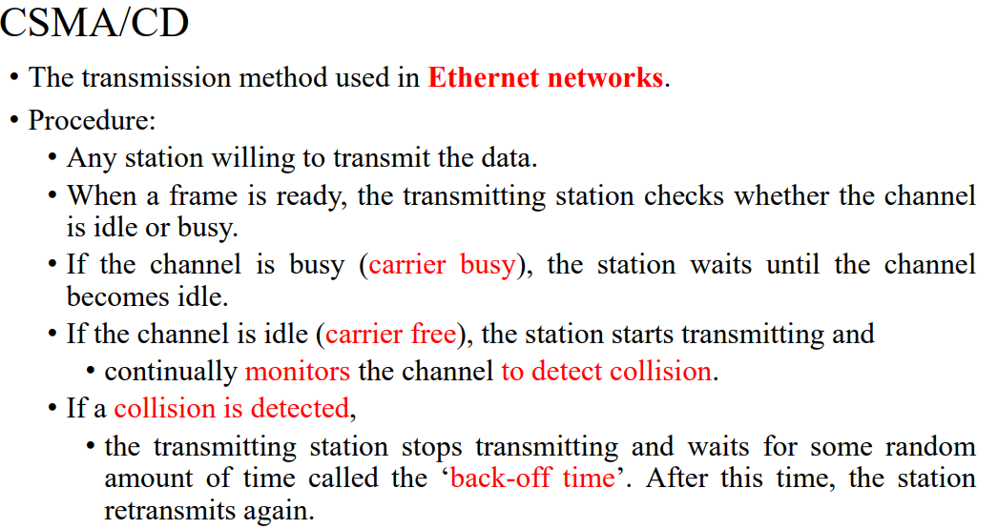

Slide 11
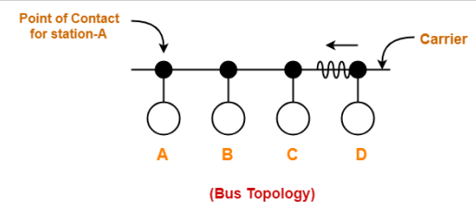
Case 1
Consider we have four stations A, B, C and D. Let the propagation delay from station A to station D be 1 hour i.e. if the data packet bit starts to move at 10 a.m., then it will reach D at 11 a.m.
• At 10 a.m. both the stations, A and D sense the carrier as free and start their transmission.
• If the total propagation delay is 1 hour, then after half an hour both the station’s first bits will reach halfway and will soon experience a collision.
• So, exactly at 10:30 a.m., there will be a collision which will produce collision signals.
• At 11 a.m. the collision signals will reach stations A and D i.e. exactly after one hour the stations receive the collision signal

Slide 12
Therefore, for the respective stations to detect that it’s their own data that got collided the transmission time for both the stations should be greater than their propagation time. i.e. Tt>Tp
• Where Tt is the transmission time and Tp is the propagation time

Slide 13
Case 2
Station A started the transmission at 10 a.m. and is about to reach station D at 10:59:59 a.m.
• At this time, station D started its transmission after sensing the carrier as free.
• So here the first bit of data packet sent from station D will face collision with the data packet of station A.
• After collision occurred, the carrier starts sending a colloidal signal. • Station A will receive the collision signal after 1 hour.

Slide 14
In this is the condition for detecting collision in the worst case where if a station wants to detect collision then it should keep on transmitting the data till 2Tp, i.e. Tt>2*Tp.

Slide 15
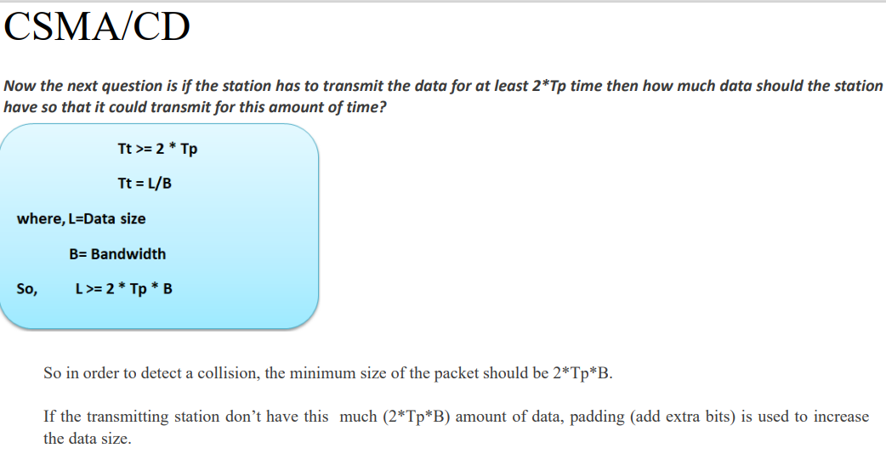

Slide 16
Efficiency = Tt / ( C*2*Tp + Tt + Tp)
Tt -> transmission time
Tp -> propagation time C -> number of collision

